Slide 1
The main problem with the IPCC view of climate change
Statement for Committee on the Environment, Nature Conservation and Nuclear Safety, Deutscher Bundestag, before COP24 in Katowice
Prof. Nir Shaviv
Chair, Department of Physics,
Hebrew University of Jerusalem
November 2018

Slide 2
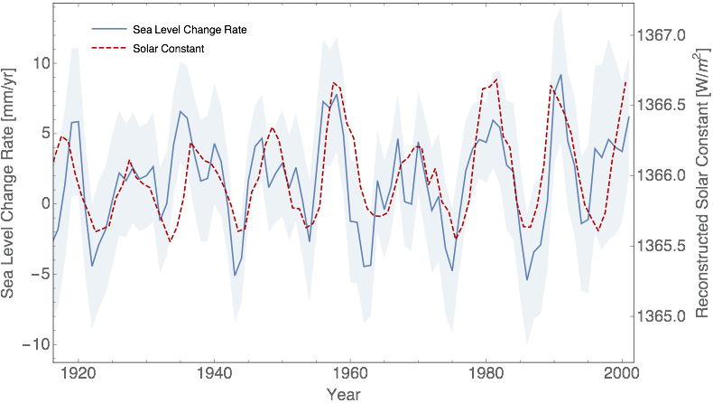
Quantifying the solar forcing
Shaviv, 2008

Slide 3
Forcing according to the IPCC AR5
IPCC
Real solar contribution (from Maunder Minimum)

